Slide 1
Fundamentals of Ecology
Week 7, Ecology Lecture 4
Cara Brook
February 16, 2023

Slide 2
Let’s recap a bit!

Slide 3
Let’s recap a bit!
Metapopulations
The term ‘metapopulation’ refers to a ‘population of populations’ that can be modeled using Levins’ patch model that describes rates of colonization and extinction for patches of habitat.
The ‘rescue effect’ described by Ilkka Hanski highlights how the probability of extinction for a subpopulation is diminished when it can be recolonized by the larger metapopulation.
Source-sink theory describes how some subpopulations within a metapopulation act as ‘sources’ where births outpace deaths, while others act as ‘sinks’ where deaths outpace births.
The term ‘ecological trap’ describes a species’ preference for poor quality habitat. When sinks outnumber sources, metapopulation dynamics can actually drive a population to extinction as individuals flock to these traps.

Slide 4
Let’s recap a bit!
Metapopulations
The term ‘metapopulation’ refers to a ‘population of populations’ that can be modeled using Levins’ patch model that describes rates of colonization and extinction for patches of habitat.
The ‘rescue effect’ described by Ilkka Hanski highlights how the probability of extinction for a subpopulation is diminished when it can be recolonized by the larger metapopulation.
Source-sink theory describes how some subpopulations within a metapopulation act as ‘sources’ where births outpace deaths, while others act as ‘sinks’ where deaths outpace births.
The term ‘ecological trap’ describes a species’ preference for poor quality habitat. When sinks outnumber sources, metapopulation dynamics can actually drive a population to extinction as individuals flock to these traps.

Slide 5
Let’s recap a bit!
Metapopulations
The term ‘metapopulation’ refers to a ‘population of populations’ that can be modeled using Levins’ patch model that describes rates of colonization and extinction for patches of habitat.
The ‘rescue effect’ described by Ilkka Hanski highlights how the probability of extinction for a subpopulation is diminished when it can be recolonized by the larger metapopulation.
Source-sink theory describes how some subpopulations within a metapopulation act as ‘sources’ where births outpace deaths, while others act as ‘sinks’ where deaths outpace births.
The term ‘ecological trap’ describes a species’ preference for poor quality habitat. When sinks outnumber sources, metapopulation dynamics can actually drive a population to extinction as individuals flock to these traps.

Slide 6
Let’s recap a bit!
Metapopulations
The term ‘metapopulation’ refers to a ‘population of populations’ that can be modeled using Levins’ patch model that describes rates of colonization and extinction for patches of habitat.
The ‘rescue effect’ described by Ilkka Hanski highlights how the probability of extinction for a subpopulation is diminished when it can be recolonized by the larger metapopulation.
Source-sink theory describes how some subpopulations within a metapopulation act as ‘sources’ where births outpace deaths, while others act as ‘sinks’ where deaths outpace births.
The term ‘ecological trap’ describes a species’ preference for poor quality habitat. When sinks outnumber sources, metapopulation dynamics can actually drive a population to extinction as individuals flock to these traps.

Slide 7
Let’s recap a bit!
Interspecies interactions
A community is the level of ecological organization in which multiple species interact: mutualism, commensalism, predation, competition (direct & indirect), and parasitism
Trophic levels are hierarchical levels of organization in an ecosystem, based on nutritional relationships to the source of energy (primary producer, primary consumer)
Food chains and food webs demonstrate interactions across trophic levels
Bottom-up processes describe circumstances when a higher trophic level is limited by the availability of resources provided from a trophic level below it.
Top-down processes describe circumstances in which a higher trophic level regulates a lower trophic level, usually through consumption. First described in HSS.
The Lotka-Volterra predator-prey model describes the simplest interactions across just two trophic levels. It has been used to describe dynamics in several famous examples (lynx-hare, wolf-moose) though it often oversimplifies interspecies interactions
Trophic cascades occur when species indirectly interact across 3 trophic levels. We discussed several famous examples: Pisaster, CA sea otter, Yellowstone wolf, wildebeest

Slide 8
Let’s recap a bit!
Interspecies interactions
A community is the level of ecological organization in which multiple species interact: mutualism, commensalism, predation, competition (direct & indirect), and parasitism
Trophic levels are hierarchical levels of organization in an ecosystem, based on nutritional relationships to the source of energy (primary producer, primary consumer)
Food chains and food webs demonstrate interactions across trophic levels
Bottom-up processes describe circumstances when a higher trophic level is limited by the availability of resources provided from a trophic level below it.
Top-down processes describe circumstances in which a higher trophic level regulates a lower trophic level, usually through consumption. First described in HSS.
The Lotka-Volterra predator-prey model describes the simplest interactions across just two trophic levels. It has been used to describe dynamics in several famous examples (lynx-hare, wolf-moose) though it often oversimplifies interspecies interactions
Trophic cascades occur when species indirectly interact across 3 trophic levels. We discussed several famous examples: Pisaster, CA sea otter, Yellowstone wolf, wildebeest

Slide 9
Let’s recap a bit!
Interspecies interactions
A community is the level of ecological organization in which multiple species interact: mutualism, commensalism, predation, competition (direct & indirect), and parasitism
Trophic levels are hierarchical levels of organization in an ecosystem, based on nutritional relationships to the source of energy (primary producer, primary consumer)
Food chains and food webs demonstrate interactions across trophic levels
Bottom-up processes describe circumstances when a higher trophic level is limited by the availability of resources provided from a trophic level below it.
Top-down processes describe circumstances in which a higher trophic level regulates a lower trophic level, usually through consumption. First described in HSS.
The Lotka-Volterra predator-prey model describes the simplest interactions across just two trophic levels. It has been used to describe dynamics in several famous examples (lynx-hare, wolf-moose) though it often oversimplifies interspecies interactions
Trophic cascades occur when species indirectly interact across 3 trophic levels. We discussed several famous examples: Pisaster, CA sea otter, Yellowstone wolf, wildebeest

Slide 10
Let’s recap a bit!
Interspecies interactions
A community is the level of ecological organization in which multiple species interact: mutualism, commensalism, predation, competition (direct & indirect), and parasitism
Trophic levels are hierarchical levels of organization in an ecosystem, based on nutritional relationships to the source of energy (primary producer, primary consumer)
Food chains and food webs demonstrate interactions across trophic levels
Bottom-up processes describe circumstances when a higher trophic level is limited by the availability of resources provided from a trophic level below it.
Top-down processes describe circumstances in which a higher trophic level regulates a lower trophic level, usually through consumption. First described in HSS.
The Lotka-Volterra predator-prey model describes the simplest interactions across just two trophic levels. It has been used to describe dynamics in several famous examples (lynx-hare, wolf-moose) though it often oversimplifies interspecies interactions
Trophic cascades occur when species indirectly interact across 3 trophic levels. We discussed several famous examples: Pisaster, CA sea otter, Yellowstone wolf, wildebeest

Slide 11
Let’s recap a bit!
Interspecies interactions
A community is the level of ecological organization in which multiple species interact: mutualism, commensalism, predation, competition (direct & indirect), and parasitism
Trophic levels are hierarchical levels of organization in an ecosystem, based on nutritional relationships to the source of energy (primary producer, primary consumer)
Food chains and food webs demonstrate interactions across trophic levels
Bottom-up processes describe circumstances when a higher trophic level is limited by the availability of resources provided from a trophic level below it.
Top-down processes describe circumstances in which a higher trophic level regulates a lower trophic level, usually through consumption. First described in HSS.
The Lotka-Volterra predator-prey model describes the simplest interactions across just two trophic levels. It has been used to describe dynamics in several famous examples (lynx-hare, wolf-moose) though it often oversimplifies interspecies interactions
Trophic cascades occur when species indirectly interact across 3 trophic levels. We discussed several famous examples: Pisaster, CA sea otter, Yellowstone wolf, wildebeest

Slide 12
Let’s recap a bit!
Interspecies interactions
A community is the level of ecological organization in which multiple species interact: mutualism, commensalism, predation, competition (direct & indirect), and parasitism
Trophic levels are hierarchical levels of organization in an ecosystem, based on nutritional relationships to the source of energy (primary producer, primary consumer)
Food chains and food webs demonstrate interactions across trophic levels
Bottom-up processes describe circumstances when a higher trophic level is limited by the availability of resources provided from a trophic level below it.
Top-down processes describe circumstances in which a higher trophic level regulates a lower trophic level, usually through consumption. First described in HSS.
The Lotka-Volterra predator-prey model describes the simplest interactions across just two trophic levels. It has been used to describe dynamics in several famous examples (lynx-hare, wolf-moose) though it often oversimplifies interspecies interactions
Trophic cascades occur when species indirectly interact across 3 trophic levels. We discussed several famous examples: Pisaster, CA sea otter, Yellowstone wolf, wildebeest

Slide 13
Let’s recap a bit!
Interspecies interactions
A community is the level of ecological organization in which multiple species interact: mutualism, commensalism, predation, competition (direct & indirect), and parasitism
Trophic levels are hierarchical levels of organization in an ecosystem, based on nutritional relationships to the source of energy (primary producer, primary consumer)
Food chains and food webs demonstrate interactions across trophic levels
Bottom-up processes describe circumstances when a higher trophic level is limited by the availability of resources provided from a trophic level below it.
Top-down processes describe circumstances in which a higher trophic level regulates a lower trophic level, usually through consumption. First described in HSS.
The Lotka-Volterra predator-prey model describes the simplest interactions across just two trophic levels. It has been used to describe dynamics in several famous examples (lynx-hare, wolf-moose) though it often oversimplifies interspecies interactions
Trophic cascades occur when species indirectly interact across 3 trophic levels. We discussed several famous examples: Pisaster, CA sea otter, Yellowstone wolf, wildebeest

Slide 14
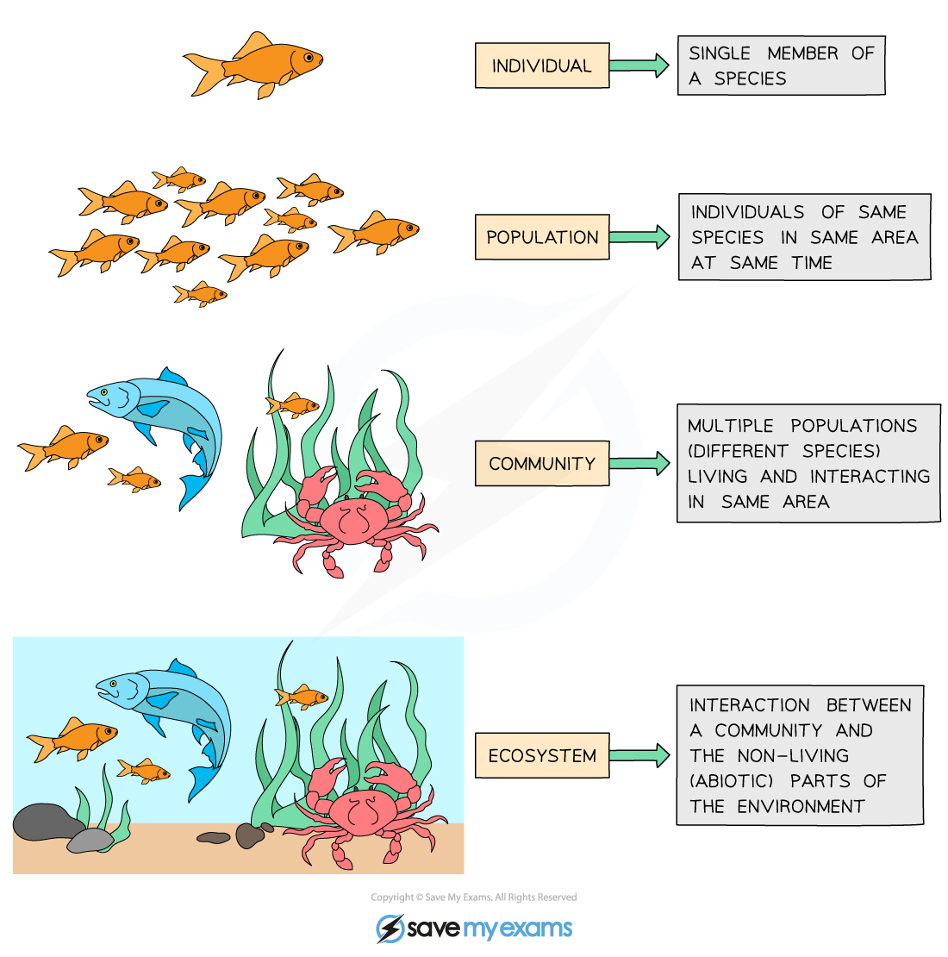
Community = interacting populations of different species
individual
population
fish
(x)
metapopulation
shark
(y)
community
How does fish abundance vary with changes in shark abundance?
ecosystem

Slide 15
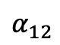
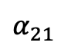
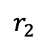
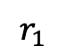
Community = interacting populations of different species
individual
population
$$α_{12}$$
$$r_{1}$$
metapopulation
Fish A
(x₁)
Fish B
(x₂)
$$r_{2}$$
community
$$α_{21}$$
How does the abundance of fish species A vary with changes in the abundance of fish species B?
ecosystem

Slide 16
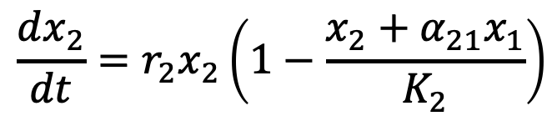
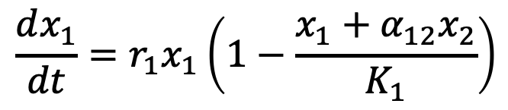
Lotka-Volterra equation can be modified for interspecies competition.
$$\frac{dx_{1}}{dt}={r_{1}x}_{1}\left(1−\frac{x_{1}+α_{12}x_{2}}{K_{1}}\right)$$
$$\frac{dx_{2}}{dt}={r_{2}x}_{2}\left(1−\frac{x_{2}+α_{21}x_{1}}{K_{2}}\right)$$

Slide 17
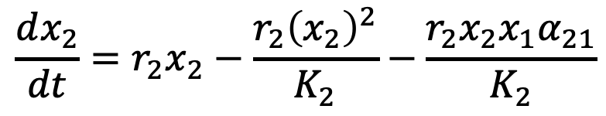
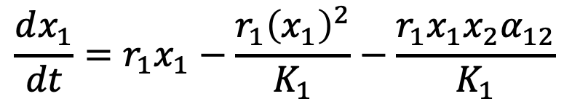
Lotka-Volterra equation can be modified for interspecies competition.
$$\frac{dx_{1}}{dt}={r_{1}x}_{1}−\frac{r_{1}{\left(x_{1}\right)}^{2}}{K_{1}}−\frac{r_{1}x_{1}x_{2}α_{12}}{K_{1}}$$
$$\frac{dx_{2}}{dt}={r_{2}x}_{2}−\frac{r_{2}{\left(x_{2}\right)}^{2}}{K_{2}}−\frac{r_{2}x_{2}x_{1}α_{21}}{K_{2}}$$

Slide 18
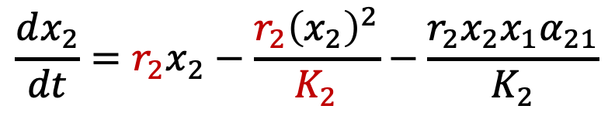
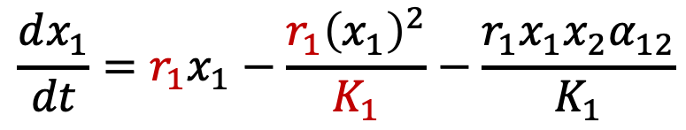
Lotka-Volterra equation can be modified for interspecies competition.
intraspecies competition of species 1 (akin to logistic growth)
Each species is self-regulated by logistic growth and its own carrying capacity (K) and growth rate (r).
But also regulated by the density of its competitor (e.g. for a specific resource).
$$\frac{dx_{1}}{dt}={r_{1}x}_{1}−\frac{r_{1}{\left(x_{1}\right)}^{2}}{K_{1}}−\frac{r_{1}x_{1}x_{2}α_{12}}{K_{1}}$$
$$\frac{dx_{2}}{dt}={r_{2}x}_{2}−\frac{r_{2}{\left(x_{2}\right)}^{2}}{K_{2}}−\frac{r_{2}x_{2}x_{1}α_{21}}{K_{2}}$$
intraspecies competition of species 2

Slide 19
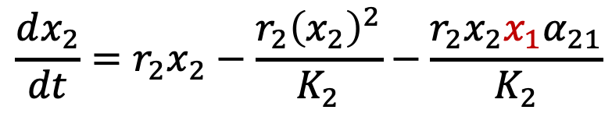
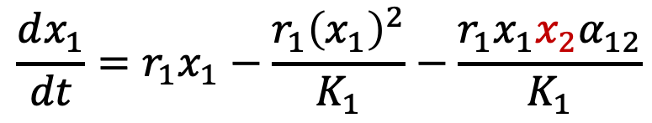
Lotka-Volterra equation can be modified for interspecies competition.
intraspecies competition of species 1 (akin to logistic growth)
interspecies competition with species 2
Each species is self- regulated by logistic growth and its own carrying capacity (K) and growth rate (r).
Each species is also regulated by the density of its competitor (e.g. for a specific resource).
$$\frac{dx_{1}}{dt}={r_{1}x}_{1}−\frac{r_{1}{\left(x_{1}\right)}^{2}}{K_{1}}−\frac{r_{1}x_{1}x_{2}α_{12}}{K_{1}}$$
$$\frac{dx_{2}}{dt}={r_{2}x}_{2}−\frac{r_{2}{\left(x_{2}\right)}^{2}}{K_{2}}−\frac{r_{2}x_{2}x_{1}α_{21}}{K_{2}}$$
intraspecies competition of species 2
interspecies competition with species 1

Slide 20
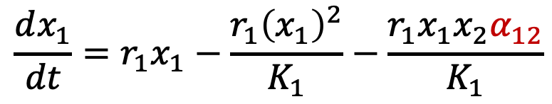
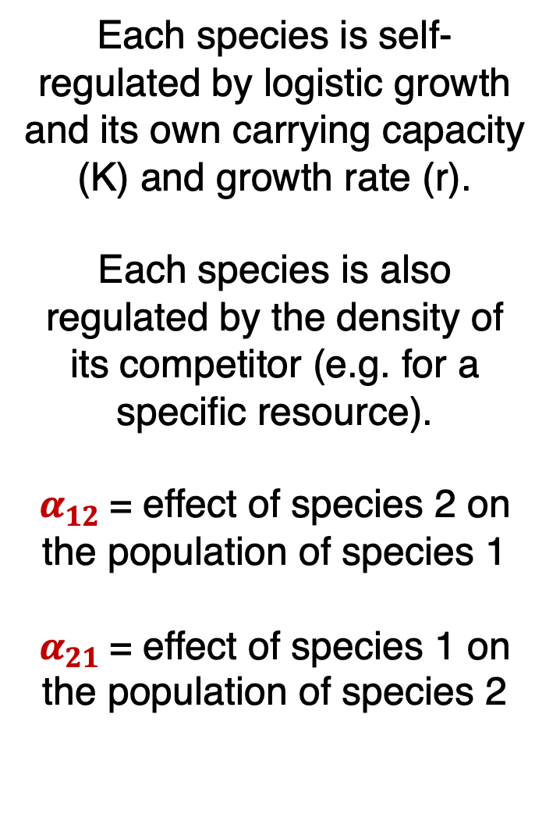

Lotka-Volterra equation can be modified for interspecies competition.
intraspecies competition of species 1 (akin to logistic growth)
interspecies competition with species 2
Each species is self- regulated by logistic growth and its own carrying capacity (K) and growth rate (r).
Each species is also regulated by the density of its competitor (e.g. for a specific resource).
$α_{12}$= effect of species 2 on the population of species 1
$α_{21}$= effect of species 1 on the population of species 2
$$\frac{dx_{1}}{dt}={r_{1}x}_{1}−\frac{r_{1}{\left(x_{1}\right)}^{2}}{K_{1}}−\frac{r_{1}x_{1}x_{2}α_{12}}{K_{1}}$$
$$\frac{dx_{2}}{dt}={r_{2}x}_{2}−\frac{r_{2}{\left(x_{2}\right)}^{2}}{K_{2}}−\frac{r_{2}x_{2}x_{1}α_{21}}{K_{2}}$$
intraspecies competition of species 2
interspecies competition with species 1

Slide 21
The 2-species Lotka-Volterra competition model has four equilibria.
Remember: equilibrium occurs when neither population is changing!

Slide 22
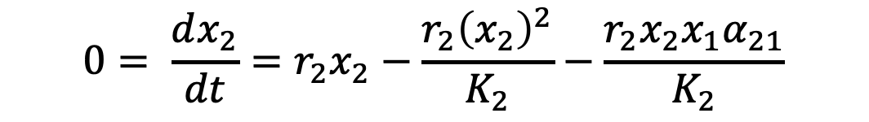
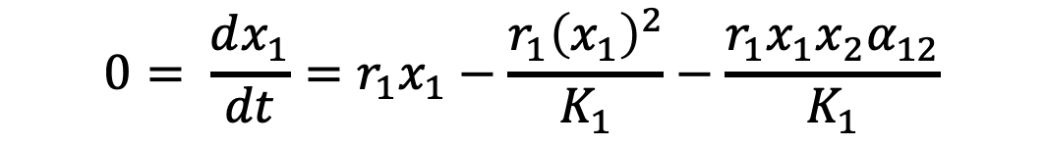
The 2-species Lotka-Volterra competition model has four equilibria.
Remember: equilibrium occurs when neither population is changing!
$$0= \frac{dx_{1}}{dt}={r_{1}x}_{1}−\frac{r_{1}{\left(x_{1}\right)}^{2}}{K_{1}}−\frac{r_{1}x_{1}x_{2}α_{12}}{K_{1}}$$
$$0= \frac{dx_{2}}{dt}={r_{2}x}_{2}−\frac{r_{2}{\left(x_{2}\right)}^{2}}{K_{2}}−\frac{r_{2}x_{2}x_{1}α_{21}}{K_{2}}$$

Slide 23
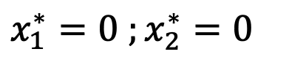
The 2-species Lotka-Volterra competition model has four equilibria.
Remember: equilibrium occurs when neither population is changing!
$$0= \frac{dx_{1}}{dt}={r_{1}x}_{1}−\frac{r_{1}{\left(x_{1}\right)}^{2}}{K_{1}}−\frac{r_{1}x_{1}x_{2}α_{12}}{K_{1}}$$
$$0= \frac{dx_{2}}{dt}={r_{2}x}_{2}−\frac{r_{2}{\left(x_{2}\right)}^{2}}{K_{2}}−\frac{r_{2}x_{2}x_{1}α_{21}}{K_{2}}$$
Four equilibria at:
$$x_{1}^{∗}=0 ;x_{2}^{∗}=0$$
Trivial.

Slide 24
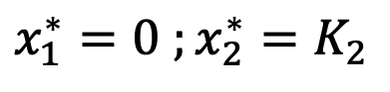
The 2-species Lotka-Volterra competition model has four equilibria.
Remember: equilibrium occurs when neither population is changing!
$$0= \frac{dx_{1}}{dt}={r_{1}x}_{1}−\frac{r_{1}{\left(x_{1}\right)}^{2}}{K_{1}}−\frac{r_{1}x_{1}x_{2}α_{12}}{K_{1}}$$
$$0= \frac{dx_{2}}{dt}={r_{2}x}_{2}−\frac{r_{2}{\left(x_{2}\right)}^{2}}{K_{2}}−\frac{r_{2}x_{2}x_{1}α_{21}}{K_{2}}$$
Four equilibria at:
$$x_{1}^{∗}=0 ;x_{2}^{∗}=0$$
$$x_{1}^{∗}=0 ;x_{2}^{∗}=K_{2}$$
Species 1 extinct. Species 2 at carrying capacity.

Slide 25
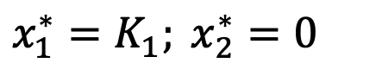
The 2-species Lotka-Volterra competition model has four equilibria.
Remember: equilibrium occurs when neither population is changing!
$$0= \frac{dx_{1}}{dt}={r_{1}x}_{1}−\frac{r_{1}{\left(x_{1}\right)}^{2}}{K_{1}}−\frac{r_{1}x_{1}x_{2}α_{12}}{K_{1}}$$
$$0= \frac{dx_{2}}{dt}={r_{2}x}_{2}−\frac{r_{2}{\left(x_{2}\right)}^{2}}{K_{2}}−\frac{r_{2}x_{2}x_{1}α_{21}}{K_{2}}$$
Four equilibria at:
$$x_{1}^{∗}=0 ;x_{2}^{∗}=0$$
$$x_{1}^{∗}=0 ;x_{2}^{∗}=K_{2}$$
$$x_{1}^{∗}=K_{1}; x_{2}^{∗}=0$$
Species 2 extinct. Species 1 at carrying capacity.

Slide 26
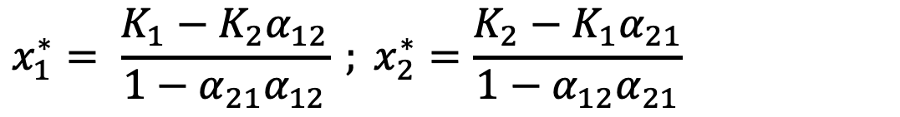
The 2-species Lotka-Volterra competition model has four equilibria.
Remember: equilibrium occurs when neither population is changing!
$$0= \frac{dx_{1}}{dt}={r_{1}x}_{1}−\frac{r_{1}{\left(x_{1}\right)}^{2}}{K_{1}}−\frac{r_{1}x_{1}x_{2}α_{12}}{K_{1}}$$
$$0= \frac{dx_{2}}{dt}={r_{2}x}_{2}−\frac{r_{2}{\left(x_{2}\right)}^{2}}{K_{2}}−\frac{r_{2}x_{2}x_{1}α_{21}}{K_{2}}$$
Four equilibria at:
$$x_{1}^{∗}=0 ;x_{2}^{∗}=0$$
$$x_{1}^{∗}=0 ;x_{2}^{∗}=K_{2}$$
$$x_{1}^{∗}=K_{1}; x_{2}^{∗}=0$$
$$x_{1}^{∗}= \frac{K_{1}−K_{2}α_{12}}{1−α_{21}α_{12}} ; x_{2}^{∗}=\frac{K_{2}−K_{1}α_{21}}{1−α_{12}α_{21}}$$
Coexistence.

Slide 27
Nullclines (or isoclines) of the Lotka-Volterra competition model
These are the lines that correspond to the conditions when the rate of change for one species is not changing!

Slide 28
For 2024, explain these phase planes as trajectories of the system. Each nullcline represents the conditions under which the RATE of change for each species is not changing. The two will eventually converge to the equilibria but at different rates. That rate will cease changing for each species when you reach the nullcline.
Also would be helpful to show the time series of the two species and how that translates to the nullcline.

Slide 29
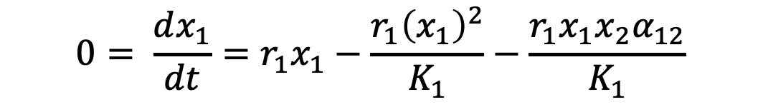
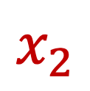
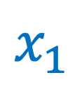
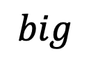
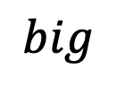
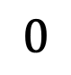
Nullclines (or isoclines) of the Lotka-Volterra competition model
These are the lines that correspond to conditions when the rate of change for one species is 0.
Nullclines for species 1 occur at all conditions for which $\frac{dx_{1}}{dt}=0$
$$0= \frac{dx_{1}}{dt}={r_{1}x}_{1}−\frac{r_{1}{\left(x_{1}\right)}^{2}}{K_{1}}−\frac{r_{1}x_{1}x_{2}α_{12}}{K_{1}}$$
$$big$$
$$x_{2}$$
$$0$$
$$x_{1}$$
$$big$$

Slide 30


Nullclines (or isoclines) of the Lotka-Volterra competition model
These are the lines that correspond to conditions when the rate of change for one species is 0.
Nullclines for species 1 occur at all conditions for which $\frac{dx_{1}}{dt}=0$
$$0= \frac{dx_{1}}{dt}={r_{1}x}_{1}−\frac{r_{1}{\left(x_{1}\right)}^{2}}{K_{1}}−\frac{r_{1}x_{1}x_{2}α_{12}}{K_{1}}$$
$$big$$
$$0={r_{1}x}_{1}−\frac{r_{1}{\left(x_{1}\right)}^{2}}{K_{1}}−\frac{r_{1}x_{1}x_{2}α_{12}}{K_{1}}$$
$$0={r_{1}x}_{1}\left(1−\frac{x_{1}}{K_{1}}−\frac{x_{2}α_{12}}{K_{1}}\right)$$
$$x_{2}$$
$$0$$
$$x_{1}$$
$$big$$

Slide 31
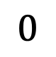
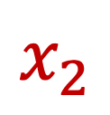
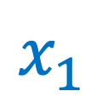

Nullclines (or isoclines) of the Lotka-Volterra competition model
These are the lines that correspond to conditions when the rate of change for one species is 0.
Nullclines for species 1 occur at all conditions for which $\frac{dx_{1}}{dt}=0$
$$0= \frac{dx_{1}}{dt}={r_{1}x}_{1}−\frac{r_{1}{\left(x_{1}\right)}^{2}}{K_{1}}−\frac{r_{1}x_{1}x_{2}α_{12}}{K_{1}}$$
$$0={r_{1}x}_{1}−\frac{r_{1}{\left(x_{1}\right)}^{2}}{K_{1}}−\frac{r_{1}x_{1}x_{2}α_{12}}{K_{1}}$$
$$0={r_{1}x}_{1}\left(1−\frac{x_{1}}{K_{1}}−\frac{x_{2}α_{12}}{K_{1}}\right)$$
$$x_{2}$$
first nullcline at $x_{1}=0$
$$0$$
$$x_{1}$$

Slide 32
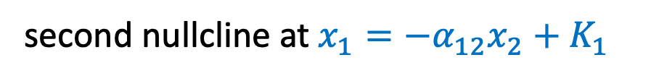
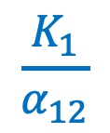
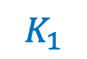
Nullclines (or isoclines) of the Lotka-Volterra competition model
These are the lines that correspond to conditions when the rate of change for one species is 0.
Nullclines for species 1 occur at all conditions for which $\frac{dx_{1}}{dt}=0$
$$0= \frac{dx_{1}}{dt}={r_{1}x}_{1}−\frac{r_{1}{\left(x_{1}\right)}^{2}}{K_{1}}−\frac{r_{1}x_{1}x_{2}α_{12}}{K_{1}}$$
$$\frac{K_{1}}{α_{12}}$$
$$0={r_{1}x}_{1}−\frac{r_{1}{\left(x_{1}\right)}^{2}}{K_{1}}−\frac{r_{1}x_{1}x_{2}α_{12}}{K_{1}}$$
$$0={r_{1}x}_{1}\left(1−\frac{x_{1}}{K_{1}}−\frac{x_{2}α_{12}}{K_{1}}\right)$$
$$x_{2}$$
first nullcline at $x_{1}=0$
second nullcline at $x_{1}=−α_{12}x_{2}+K_{1}$
$$0$$
$$x_{1}$$
$$K_{1}$$

Slide 33
Nullclines (or isoclines) of the Lotka-Volterra competition model
Following a perturbation, the population should return to equilibrium!
$$\frac{K_{1}}{α_{12}}$$
$$x_{2}$$
$$0$$
$$x_{1}$$
$$K_{1}$$

Slide 34
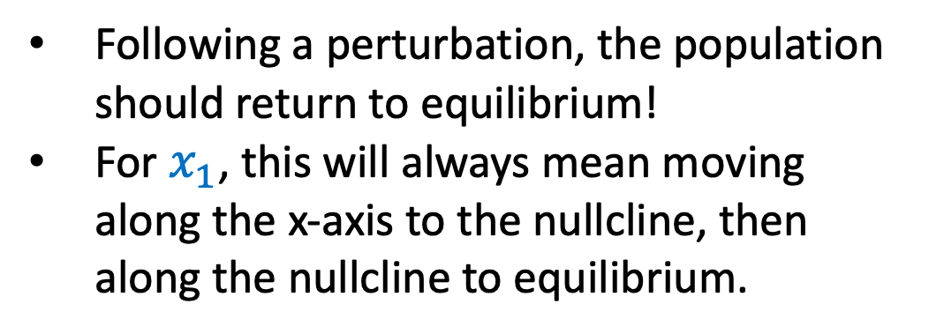
Nullclines (or isoclines) of the Lotka-Volterra competition model
Following a perturbation, the population should return to equilibrium!
For $x_{1}$, this will always mean moving along the x-axis to the nullcline, then along the nullcline to equilibrium.
$$\frac{K_{1}}{α_{12}}$$
$$x_{2}$$
$$0$$
$$x_{1}$$
$$K_{1}$$

Slide 35
Nullclines (or isoclines) of the Lotka-Volterra competition model
Following a perturbation, the population should return to equilibrium!
For $x_{1}$, this will always mean moving along the x-axis to the nullcline, then along the nullcline to equilibrium.
$$\frac{K_{1}}{α_{12}}$$
$$x_{2}$$
$$0$$
$$x_{1}$$
$$K_{1}$$

Slide 36

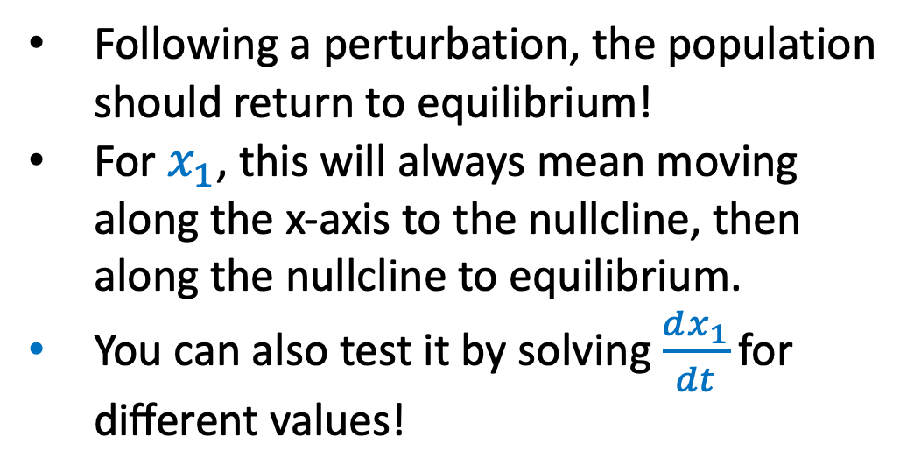
Nullclines (or isoclines) of the Lotka-Volterra competition model
$$\frac{dx_{1}}{dt}={r_{1}x}_{1}\left(1−\frac{x_{1}}{K_{1}}−\frac{x_{2}α_{12}}{K_{1}}\right)$$
Following a perturbation, the population should return to equilibrium!
For $x_{1}$, this will always mean moving along the x-axis to the nullcline, then along the nullcline to equilibrium.
You can also test it by solving $\frac{dx_{1}}{dt}\text{for} \text{different} \text{values}\text{!}$
$$\frac{K_{1}}{α_{12}}$$
$$x_{2}$$
$$0$$
$$x_{1}$$
$$K_{1}$$

Slide 37
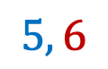
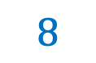
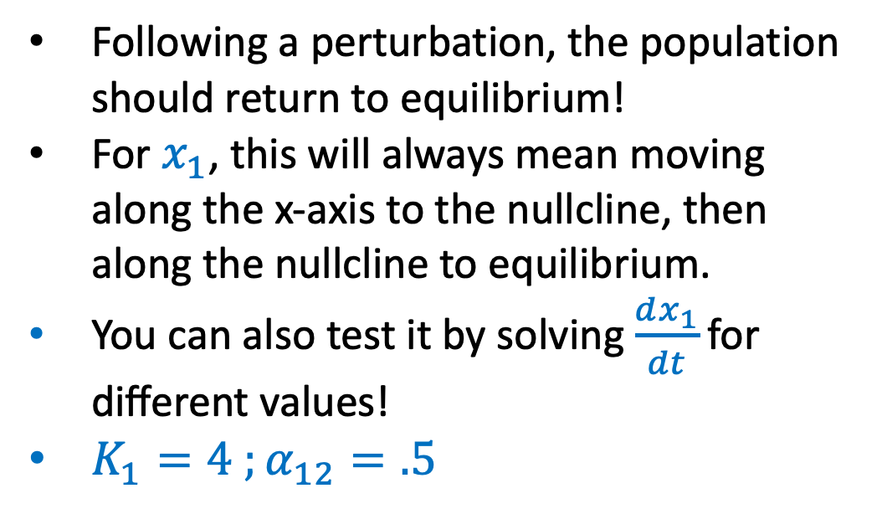
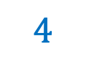

Nullclines (or isoclines) of the Lotka-Volterra competition model
$$\frac{dx_{1}}{dt}={r_{1}x}_{1}\left(1−\frac{x_{1}}{K_{1}}−\frac{x_{2}α_{12}}{K_{1}}\right)$$
Following a perturbation, the population should return to equilibrium!
For $x_{1}$, this will always mean moving along the x-axis to the nullcline, then along the nullcline to equilibrium.
You can also test it by solving $\frac{dx_{1}}{dt}\text{for} \text{different} \text{values}\text{!}$
$K_{1}=4 ;α_{12}=.5$
$$8$$
$$5, 6$$
$$x_{2}$$
$$0$$
$$x_{1}$$
$$4$$

Slide 38

Nullclines (or isoclines) of the Lotka-Volterra competition model
$$\frac{dx_{1}}{dt}={r_{1}x}_{1}\left(1−\frac{x_{1}}{K_{1}}−\frac{x_{2}α_{12}}{K_{1}}\right)$$
Following a perturbation, the population should return to equilibrium!
For $x_{1}$, this will always mean moving along the x-axis to the nullcline, then along the nullcline to equilibrium.
You can also test it by solving $\frac{dx_{1}}{dt}\text{for} \text{different} \text{values}\text{!}$
$K_{1}=4 ;α_{12}=.5$
$$\frac{dx_{1}}{dt}=r_{1}∗5\left(1−\frac{5}{4}−\frac{6∗.5}{4}\right)$$
$$8$$
$$5, 6$$
$$x_{2}$$
$$0$$
$$x_{1}$$
$$4$$

Slide 39

Nullclines (or isoclines) of the Lotka-Volterra competition model
$$\frac{dx_{1}}{dt}={r_{1}x}_{1}\left(1−\frac{x_{1}}{K_{1}}−\frac{x_{2}α_{12}}{K_{1}}\right)$$
Following a perturbation, the population should return to equilibrium!
For $x_{1}$, this will always mean moving along the x-axis to the nullcline, then along the nullcline to equilibrium.
You can also test it by solving $\frac{dx_{1}}{dt}\text{for} \text{different} \text{values}\text{!}$
$K_{1}=4 ;α_{12}=.5$
$$\frac{dx_{1}}{dt}=r_{1}∗5\left(1−\frac{5}{4}−\frac{6∗.5}{4}\right)$$
$$\frac{dx_{1}}{dt}=r_{1}∗5\left(1−1.25−.75\right)$$
$$8$$
$$5, 6$$
$$x_{2}$$
$$0$$
$$x_{1}$$
$$4$$

Slide 40

Nullclines (or isoclines) of the Lotka-Volterra competition model
$$\frac{dx_{1}}{dt}={r_{1}x}_{1}\left(1−\frac{x_{1}}{K_{1}}−\frac{x_{2}α_{12}}{K_{1}}\right)$$
Following a perturbation, the population should return to equilibrium!
For $x_{1}$, this will always mean moving along the x-axis to the nullcline, then along the nullcline to equilibrium.
You can also test it by solving $\frac{dx_{1}}{dt}\text{for} \text{different} \text{values}\text{!}$
$K_{1}=4 ;α_{12}=.5$
$$\frac{dx_{1}}{dt}=r_{1}∗5\left(1−\frac{5}{4}−\frac{6∗.5}{4}\right)$$
$$\frac{dx_{1}}{dt}=\left(−\right)$$
$$8$$
$$5, 6$$
$$x_{2}$$
$$0$$
$$x_{1}$$
$$4$$

Slide 41
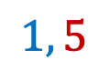
Nullclines (or isoclines) of the Lotka-Volterra competition model
$$\frac{dx_{1}}{dt}={r_{1}x}_{1}\left(1−\frac{x_{1}}{K_{1}}−\frac{x_{2}α_{12}}{K_{1}}\right)$$
Following a perturbation, the population should return to equilibrium!
For $x_{1}$, this will always mean moving along the x-axis to the nullcline, then along the nullcline to equilibrium.
You can also test it by solving $\frac{dx_{1}}{dt}\text{for} \text{different} \text{values}\text{!}$
$K_{1}=4 ;α_{12}=.5$
$$8$$
$$x_{2}$$
$$1, 5$$
$$0$$
$$x_{1}$$
$$4$$

Slide 42

Nullclines (or isoclines) of the Lotka-Volterra competition model
$$\frac{dx_{1}}{dt}={r_{1}x}_{1}\left(1−\frac{x_{1}}{K_{1}}−\frac{x_{2}α_{12}}{K_{1}}\right)$$
Following a perturbation, the population should return to equilibrium!
For $x_{1}$, this will always mean moving along the x-axis to the nullcline, then along the nullcline to equilibrium.
You can also test it by solving $\frac{dx_{1}}{dt}\text{for} \text{different} \text{values}\text{!}$
$K_{1}=4 ;α_{12}=.5$
$$\frac{dx_{1}}{dt}=r_{1}∗1\left(1−\frac{1}{4}−\frac{5∗.5}{4}\right)$$
$$8$$
$$x_{2}$$
$$1, 5$$
$$0$$
$$x_{1}$$
$$4$$

Slide 43

Nullclines (or isoclines) of the Lotka-Volterra competition model
$$\frac{dx_{1}}{dt}={r_{1}x}_{1}\left(1−\frac{x_{1}}{K_{1}}−\frac{x_{2}α_{12}}{K_{1}}\right)$$
Following a perturbation, the population should return to equilibrium!
For $x_{1}$, this will always mean moving along the x-axis to the nullcline, then along the nullcline to equilibrium.
You can also test it by solving $\frac{dx_{1}}{dt}\text{for} \text{different} \text{values}\text{!}$
$K_{1}=4 ;α_{12}=.5$
$$\frac{dx_{1}}{dt}=r_{1}∗1\left(1−\frac{1}{4}−\frac{5∗.5}{4}\right)$$
$$\frac{dx_{1}}{dt}=r_{1}∗1\left(1−.25−.56\right)$$
$$8$$
$$x_{2}$$
$$1, 5$$
$$0$$
$$x_{1}$$
$$4$$

Slide 44

Nullclines (or isoclines) of the Lotka-Volterra competition model
$$\frac{dx_{1}}{dt}={r_{1}x}_{1}\left(1−\frac{x_{1}}{K_{1}}−\frac{x_{2}α_{12}}{K_{1}}\right)$$
Following a perturbation, the population should return to equilibrium!
For $x_{1}$, this will always mean moving along the x-axis to the nullcline, then along the nullcline to equilibrium.
You can also test it by solving $\frac{dx_{1}}{dt}\text{for} \text{different} \text{values}\text{!}$
$K_{1}=4 ;α_{12}=.5$
$$\frac{dx_{1}}{dt}=r_{1}∗1\left(1−\frac{1}{4}−\frac{5∗.5}{4}\right)$$
$$\frac{dx_{1}}{dt}=\left(+\right)$$
$$8$$
$$x_{2}$$
$$1, 5$$
$$0$$
$$x_{1}$$
$$4$$

Slide 45
Nullclines (or isoclines) of the Lotka-Volterra competition model
These are the lines that correspond to conditions when the rate of change for one species is 0.
Nullclines for species 2 occur at all conditions for which $\frac{dx_{2}}{dt}=0$
$$x_{2}$$
$$0$$
$$x_{1}$$

Slide 46
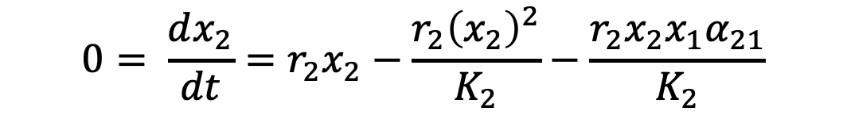


Nullclines (or isoclines) of the Lotka-Volterra competition model
These are the lines that correspond to conditions when the rate of change for one species is 0.
Nullclines for species 2 occur at all conditions for which $\frac{dx_{2}}{dt}=0$
$$0= \frac{dx_{2}}{dt}={r_{2}x}_{2}−\frac{r_{2}{\left(x_{2}\right)}^{2}}{K_{2}}−\frac{r_{2}x_{2}x_{1}α_{21}}{K_{2}}$$
$$0={r_{2}x}_{2}−\frac{r_{2}{\left(x_{2}\right)}^{2}}{K_{2}}−\frac{r_{2}x_{2}x_{1}α_{21}}{K_{2}}$$
$$0={r_{2}x}_{2}\left(1−\frac{x_{2}}{K_{2}}−\frac{x_{1}α_{21}}{K_{2}}\right)$$
$$x_{2}$$
$$0$$
$$x_{1}$$

Slide 47

Nullclines (or isoclines) of the Lotka-Volterra competition model
These are the lines that correspond to conditions when the rate of change for one species is 0.
Nullclines for species 2 occur at all conditions for which $\frac{dx_{2}}{dt}=0$
$$0= \frac{dx_{2}}{dt}={r_{2}x}_{2}−\frac{r_{2}{\left(x_{2}\right)}^{2}}{K_{2}}−\frac{r_{2}x_{2}x_{1}α_{21}}{K_{2}}$$
$$0={r_{2}x}_{2}−\frac{r_{2}{\left(x_{2}\right)}^{2}}{K_{2}}−\frac{r_{2}x_{2}x_{1}α_{21}}{K_{2}}$$
$$0={r_{2}x}_{2}\left(1−\frac{x_{2}}{K_{2}}−\frac{x_{1}α_{21}}{K_{2}}\right)$$
first nullcline at $x_{2}=0$
$$0$$
$$x_{1}$$

Slide 48
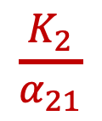
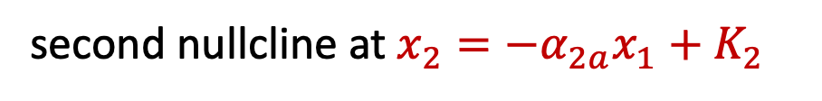

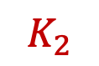
Nullclines (or isoclines) of the Lotka-Volterra competition model
These are the lines that correspond to conditions when the rate of change for one species is 0.
Nullclines for species 2 occur at all conditions for which $\frac{dx_{2}}{dt}=0$
$$0= \frac{dx_{2}}{dt}={r_{2}x}_{2}−\frac{r_{2}{\left(x_{2}\right)}^{2}}{K_{2}}−\frac{r_{2}x_{2}x_{1}α_{21}}{K_{2}}$$
$$0={r_{2}x}_{2}−\frac{r_{2}{\left(x_{2}\right)}^{2}}{K_{2}}−\frac{r_{2}x_{2}x_{1}α_{21}}{K_{2}}$$
$$0={r_{2}x}_{2}\left(1−\frac{x_{2}}{K_{2}}−\frac{x_{1}α_{21}}{K_{2}}\right)$$
$$x_{2}$$
$$K_{2}$$
first nullcline at $x_{2}=0$
second nullcline at $x_{2}=−α_{2a}x_{1}+K_{2}$
$$0$$
$$x_{1}$$
$$\frac{K_{2}}{α_{21}}$$

Slide 49
Nullclines (or isoclines) of the Lotka-Volterra competition model
Following a perturbation, the population should return to equilibrium!
$$x_{2}$$
$$K_{2}$$
$$0$$
$$x_{1}$$
$$\frac{K_{2}}{α_{21}}$$

Slide 50
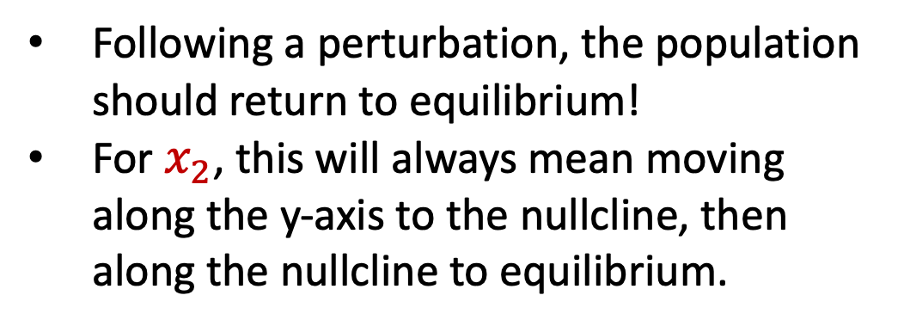
Nullclines (or isoclines) of the Lotka-Volterra competition model
Following a perturbation, the population should return to equilibrium!
For $x_{2}$, this will always mean moving along the y-axis to the nullcline, then along the nullcline to equilibrium.
$$x_{2}$$
$$K_{2}$$
$$0$$
$$x_{1}$$
$$\frac{K_{2}}{α_{21}}$$

Slide 51
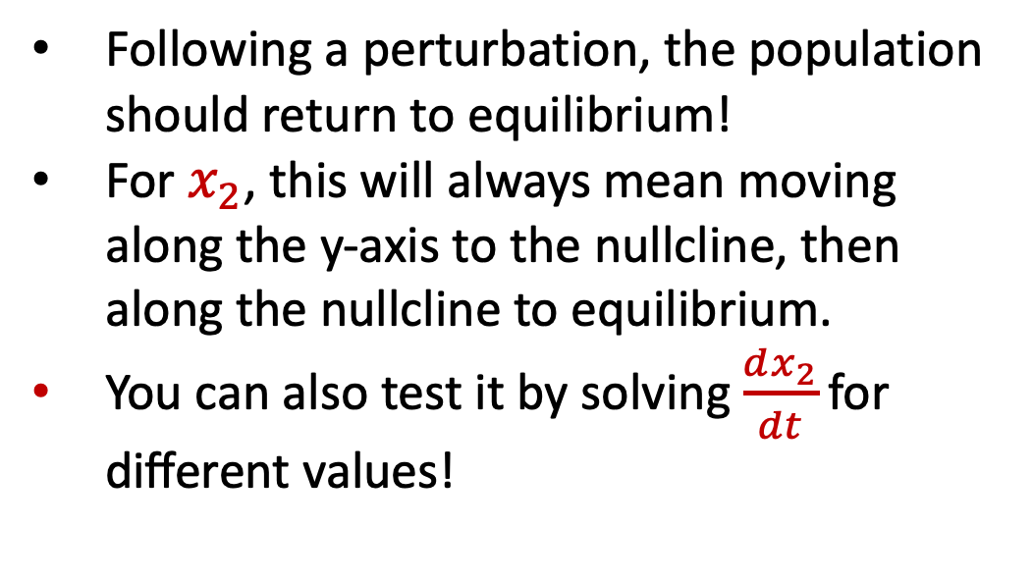
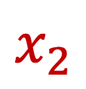

Nullclines (or isoclines) of the Lotka-Volterra competition model
$${{\frac{dx_{2}}{dt}=r}_{2}x}_{2}\left(1−\frac{x_{2}}{K_{2}}−\frac{x_{1}α_{21}}{K_{2}}\right)$$
Following a perturbation, the population should return to equilibrium!
For $x_{2}$, this will always mean moving along the y-axis to the nullcline, then along the nullcline to equilibrium.
You can also test it by solving $\frac{dx_{2}}{dt}\text{for} \text{different} \text{values}\text{!}$
$$x_{2}$$
$$K_{2}$$
$$0$$
$$x_{1}$$
$$\frac{K_{2}}{α_{21}}$$

Slide 52
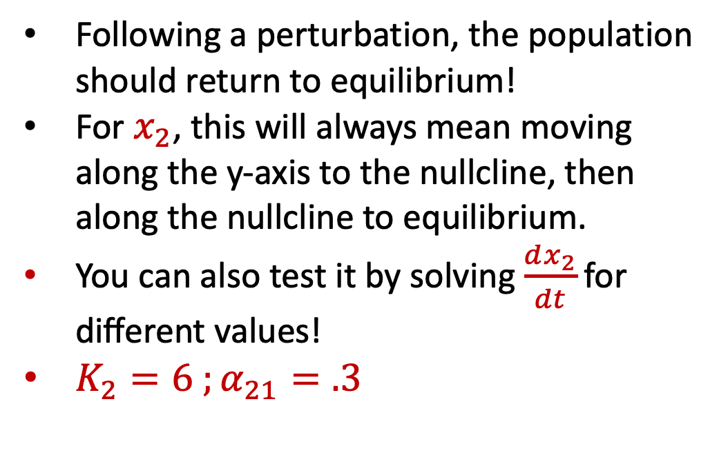
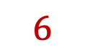
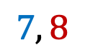

Nullclines (or isoclines) of the Lotka-Volterra competition model
$${{\frac{dx_{2}}{dt}=r}_{2}x}_{2}\left(1−\frac{x_{2}}{K_{2}}−\frac{x_{1}α_{21}}{K_{2}}\right)$$
Following a perturbation, the population should return to equilibrium!
For $x_{2}$, this will always mean moving along the y-axis to the nullcline, then along the nullcline to equilibrium.
You can also test it by solving $\frac{dx_{2}}{dt}\text{for} \text{different} \text{values}\text{!}$
$K_{2}=6 ;α_{21}=.3$
$$x_{2}$$
$$7, 8$$
$$6$$
$$0$$
$$x_{1}$$
$$20$$

Slide 53

Nullclines (or isoclines) of the Lotka-Volterra competition model
$${{\frac{dx_{2}}{dt}=r}_{2}x}_{2}\left(1−\frac{x_{2}}{K_{2}}−\frac{x_{1}α_{21}}{K_{2}}\right)$$
Following a perturbation, the population should return to equilibrium!
For $x_{2}$, this will always mean moving along the y-axis to the nullcline, then along the nullcline to equilibrium.
You can also test it by solving $\frac{dx_{2}}{dt}\text{for} \text{different} \text{values}\text{!}$
$K_{2}=6 ;α_{21}=.3$
$$x_{2}$$
$${\frac{dx_{2}}{dt}=r}_{2}∗8\left(1−\frac{8}{6}−\frac{7∗.3}{6}\right)$$
$$7, 8$$
$$6$$
$$0$$
$$x_{1}$$
$$20$$

Slide 54

Nullclines (or isoclines) of the Lotka-Volterra competition model
$${{\frac{dx_{2}}{dt}=r}_{2}x}_{2}\left(1−\frac{x_{2}}{K_{2}}−\frac{x_{1}α_{21}}{K_{2}}\right)$$
Following a perturbation, the population should return to equilibrium!
For $x_{2}$, this will always mean moving along the y-axis to the nullcline, then along the nullcline to equilibrium.
You can also test it by solving $\frac{dx_{2}}{dt}\text{for} \text{different} \text{values}\text{!}$
$K_{2}=6 ;α_{21}=.3$
$$x_{2}$$
$${\frac{dx_{2}}{dt}=r}_{2}∗8\left(1−\frac{8}{6}−\frac{7∗.3}{6}\right)$$
$${\frac{dx_{2}}{dt}=r}_{2}∗8\left(1−1.3−.35\right)$$
$$7, 8$$
$$6$$
$$0$$
$$x_{1}$$
$$20$$

Slide 55


Nullclines (or isoclines) of the Lotka-Volterra competition model
$${{\frac{dx_{2}}{dt}=r}_{2}x}_{2}\left(1−\frac{x_{2}}{K_{2}}−\frac{x_{1}α_{21}}{K_{2}}\right)$$
Following a perturbation, the population should return to equilibrium!
For $x_{2}$, this will always mean moving along the y-axis to the nullcline, then along the nullcline to equilibrium.
You can also test it by solving $\frac{dx_{2}}{dt}\text{for} \text{different} \text{values}\text{!}$
$K_{2}=6 ;α_{21}=.3$
$$x_{2}$$
$${\frac{dx_{2}}{dt}=r}_{2}∗8\left(1−\frac{8}{6}−\frac{7∗.3}{6}\right)$$
$$\frac{dx_{2}}{dt}=\left(−\right)$$
$$7, 8$$
$$6$$
$$0$$
$$x_{1}$$
$$20$$

Slide 56

Nullclines (or isoclines) of the Lotka-Volterra competition model
$${{\frac{dx_{2}}{dt}=r}_{2}x}_{2}\left(1−\frac{x_{2}}{K_{2}}−\frac{x_{1}α_{21}}{K_{2}}\right)$$
Following a perturbation, the population should return to equilibrium!
For $x_{2}$, this will always mean moving along the y-axis to the nullcline, then along the nullcline to equilibrium.
You can also test it by solving $\frac{dx_{2}}{dt}\text{for} \text{different} \text{values}\text{!}$
$K_{2}=6 ;α_{21}=.3$
$$x_{2}$$
$$6$$
$$4, 2$$
$$0$$
$$x_{1}$$
$$20$$

Slide 57

Nullclines (or isoclines) of the Lotka-Volterra competition model
$${{\frac{dx_{2}}{dt}=r}_{2}x}_{2}\left(1−\frac{x_{2}}{K_{2}}−\frac{x_{1}α_{21}}{K_{2}}\right)$$
Following a perturbation, the population should return to equilibrium!
For $x_{2}$, this will always mean moving along the y-axis to the nullcline, then along the nullcline to equilibrium.
You can also test it by solving $\frac{dx_{2}}{dt}\text{for} \text{different} \text{values}\text{!}$
$K_{2}=6 ;α_{21}=.3$
$$x_{2}$$
$${\frac{dx_{2}}{dt}=r}_{2}∗2\left(1−\frac{2}{6}−\frac{4∗.3}{6}\right)$$
$$6$$
$$4, 2$$
$$0$$
$$x_{1}$$
$$20$$

Slide 58

Nullclines (or isoclines) of the Lotka-Volterra competition model
$${{\frac{dx_{2}}{dt}=r}_{2}x}_{2}\left(1−\frac{x_{2}}{K_{2}}−\frac{x_{1}α_{21}}{K_{2}}\right)$$
Following a perturbation, the population should return to equilibrium!
For $x_{2}$, this will always mean moving along the y-axis to the nullcline, then along the nullcline to equilibrium.
You can also test it by solving $\frac{dx_{2}}{dt}\text{for} \text{different} \text{values}\text{!}$
$K_{2}=6 ;α_{21}=.3$
$$x_{2}$$
$${\frac{dx_{2}}{dt}=r}_{2}∗2\left(1−\frac{2}{6}−\frac{4∗.3}{6}\right)$$
$${\frac{dx_{2}}{dt}=r}_{2}∗2\left(1−.33−.2\right)$$
$$6$$
$$4, 2$$
$$0$$
$$x_{1}$$
$$20$$

Slide 59



Nullclines (or isoclines) of the Lotka-Volterra competition model
$${{\frac{dx_{2}}{dt}=r}_{2}x}_{2}\left(1−\frac{x_{2}}{K_{2}}−\frac{x_{1}α_{21}}{K_{2}}\right)$$
Following a perturbation, the population should return to equilibrium!
For $x_{2}$, this will always mean moving along the y-axis to the nullcline, then along the nullcline to equilibrium.
You can also test it by solving $\frac{dx_{2}}{dt}\text{for} \text{different} \text{values}\text{!}$
$K_{2}=6 ;α_{21}=.3$
$$x_{2}$$
$${\frac{dx_{2}}{dt}=r}_{2}∗2\left(1−\frac{2}{6}−\frac{4∗.3}{6}\right)$$
$$\frac{dx_{2}}{dt}=\left(+\right)$$
$$6$$
$$4, 2$$
$$0$$
$$x_{1}$$
$$20$$

Slide 60

Given different combinations of $x_{1}$and $x_{2}$ what is the outcome of competition?
$$\frac{K_{1}}{α_{12}}$$
$$x_{2}$$
$$K_{2}$$
$$0$$
$$x_{1}$$
$$K_{1}$$
$$\frac{K_{2}}{α_{21}}$$

Slide 61


Given different combinations of $x_{1}$and $x_{2}$ what is the outcome of competition?
System will converge to one of its equilibria, depending on the values of the competition and carrying capacity parameters.
We can solve $\frac{dx_{1}}{dt} \text{at} \text{different} \text{combinations} \text{of} x_{1}$and $x_{2}$ to test the direction the $x_{1}$population will move during competition (always along the x-axis).
We can solve $\frac{dx_{2}}{dt} \text{at} \text{different} \text{combinations} \text{of} x_{1}$and $x_{2}$ to test the direction the $x_{2}$population will move during competition (always along the y-axis).
$$x_{2}$$
$$\frac{K_{1}}{α_{12}}$$
$$K_{2}$$
$$0$$
$$x_{1}$$
$$K_{1}$$
$$\frac{K_{2}}{α_{21}}$$

Slide 62









Given different combinations of $x_{1}$and $x_{2}$ what is the outcome of competition?
$$\frac{K_{1}}{α_{12}}$$
$$x_{2}$$
$$x_{2}$$
$$K_{2}$$
$$0$$
$$x_{1}$$
$$0$$
$$x_{1}$$
$$K_{1}$$
$$\frac{K_{2}}{α_{21}}$$
We can use vector addition from the individual nullclines to determine the outcome of competition.

Slide 63
Given different combinations of $x_{1}$and $x_{2}$ what is the outcome of competition?
System will converge to one of its equilibria, depending on the values of the competition and carrying capacity parameters.
We can use vector addition in each quadrat from the individual nullclines to determine the outcome of competition.
$$x_{2}$$
$$\frac{K_{1}}{α_{12}}$$
$$K_{2}$$
$$0$$
$$x_{1}$$
$$K_{1}$$
$$\frac{K_{2}}{α_{21}}$$

Slide 64

Given different combinations of $x_{1}$and $x_{2}$ what is the outcome of competition?
System will converge to one of its equilibria, depending on the values of the competition and carrying capacity parameters.
We can use vector addition in each quadrat from the individual nullclines to determine the outcome of competition.
This configuration is a stable equilibrium, indicating stable coexistence at:
$$x_{2}$$
$$\frac{K_{1}}{α_{12}}$$
$$K_{2}$$
$$0$$
$$x_{1}$$
$$x_{1}^{∗}= \frac{K_{1}−K_{2}α_{12}}{1−α_{21}α_{12}} x_{2}^{∗}=\frac{K_{2}−K_{1}α_{21}}{1−α_{12}α_{21}}$$
$$K_{1}$$
$$\frac{K_{2}}{α_{21}}$$

Slide 65

Given different combinations of $x_{1}$and $x_{2}$ what is the outcome of competition?
Like before, we can also solve $\frac{dx_{1}}{dt} \text{at} \text{different} \text{combinations} \text{of} x_{1}$and $x_{2}$ to test the direction the $x_{1}$population will move during competition (always along the x-axis).
We can solve $\frac{dx_{2}}{dt} \text{at} \text{different} \text{combinations} \text{of} x_{1}$and $x_{2}$ to test the direction the $x_{2}$population will move during competition (always along the y-axis).
$$x_{2}$$
$$\frac{K_{1}}{α_{12}}$$
$$K_{2}$$
$$0$$
$$x_{1}$$
$$K_{1}$$
$$\frac{K_{2}}{α_{21}}$$

Slide 66
Given different combinations of $x_{1}$and $x_{2}$ what is the outcome of competition?
Like before, we can also solve $\frac{dx_{1}}{dt} \text{at} \text{different} \text{combinations} \text{of} x_{1}$and $x_{2}$ to test the direction the $x_{1}$population will move during competition (always along the x-axis).
We can solve $\frac{dx_{2}}{dt} \text{at} \text{different} \text{combinations} \text{of} x_{1}$and $x_{2}$ to test the direction the $x_{2}$population will move during competition (always along the y-axis).
$$x_{2}$$
$$\frac{K_{1}}{α_{12}}$$
$$K_{2}$$
$$0$$
$$x_{1}$$
$$K_{1}$$
$$\frac{K_{2}}{α_{21}}$$

Slide 67





Given different combinations of $x_{1}$and $x_{2}$ what is the outcome of competition?
Let’s try it!
$$K_{1}=2 ;α_{12}=.3$$
$$K_{2}=8 ;α_{21}=.8$$
$$x_{2}$$
$\frac{K_{1}}{α_{12}}$=10
$K_{2}$=8
$$0$$
$$x_{1}$$
$$\frac{K_{2}}{α_{21}}=10$$
$K_{1}$=2

Slide 68

Given different combinations of $x_{1}$and $x_{2}$ what is the outcome of competition?
Let’s try it!
$$K_{1}=2 ;α_{12}=.3$$
$$K_{2}=8 ;α_{21}=.8$$
$$x_{2}$$
$\frac{K_{1}}{α_{12}}$=10
$$\frac{dx_{1}}{dt}={r_{1}x}_{1}\left(1−\frac{x_{1}}{K_{1}}−\frac{x_{2}α_{12}}{K_{1}}\right)$$
$K_{2}$=8
3, 2
$$0$$
$$x_{1}$$
$$\frac{K_{2}}{α_{21}}=10$$
$K_{1}$=2

Slide 69

Given different combinations of $x_{1}$and $x_{2}$ what is the outcome of competition?
Let’s try it!
$$K_{1}=2 ;α_{12}=.3$$
$$K_{2}=8 ;α_{21}=.8$$
$$x_{2}$$
$\frac{K_{1}}{α_{12}}$=10
$$\frac{dx_{1}}{dt}={r_{1}x}_{1}\left(1−\frac{x_{1}}{K_{1}}−\frac{x_{2}α_{12}}{K_{1}}\right)$$
$K_{2}$=8
$$\frac{dx_{1}}{dt}=r_{1}∗3\left(1−\frac{3}{2}−\frac{2∗.3}{2}\right)$$
3, 2
$$0$$
$$x_{1}$$
$$\frac{K_{2}}{α_{21}}=10$$
$K_{1}$=2

Slide 70

Given different combinations of $x_{1}$and $x_{2}$ what is the outcome of competition?
Let’s try it!
$$K_{1}=2 ;α_{12}=.3$$
$$K_{2}=8 ;α_{21}=.8$$
$$x_{2}$$
$\frac{K_{1}}{α_{12}}$=10
$$\frac{dx_{1}}{dt}={r_{1}x}_{1}\left(1−\frac{x_{1}}{K_{1}}−\frac{x_{2}α_{12}}{K_{1}}\right)$$
$K_{2}$=8
$$\frac{dx_{1}}{dt}=r_{1}∗3\left(1−\frac{3}{2}−\frac{2∗.3}{2}\right)$$
3, 2
$$\frac{dx_{1}}{dt}=r_{1}∗3\left(1−1.5−0.3\right)$$
$$0$$
$$x_{1}$$
$$\frac{K_{2}}{α_{21}}=10$$
$K_{1}$=2

Slide 71




Given different combinations of $x_{1}$and $x_{2}$ what is the outcome of competition?
Let’s try it!
$$K_{1}=2 ;α_{12}=.3$$
$$K_{2}=8 ;α_{21}=.8$$
$$x_{2}$$
$\frac{K_{1}}{α_{12}}$=10
$$\frac{dx_{1}}{dt}={r_{1}x}_{1}\left(1−\frac{x_{1}}{K_{1}}−\frac{x_{2}α_{12}}{K_{1}}\right)$$
$$\frac{dx_{1}}{dt}=r_{1}∗3\left(1−\frac{3}{2}−\frac{2∗.3}{2}\right)$$
$K_{2}$=8
$$\frac{dx_{1}}{dt}=r_{1}∗3\left(1−1.5−0.3\right)$$
3, 2
$$0$$
$$x_{1}$$
$$\frac{K_{2}}{α_{21}}=10$$
$K_{1}$=2
$$\frac{dx_{1}}{dt}=\left(−\right)$$

Slide 72

Given different combinations of $x_{1}$and $x_{2}$ what is the outcome of competition?
Let’s try it!
$$K_{1}=2 ;α_{12}=.3$$
$$K_{2}=8 ;α_{21}=.8$$
$$x_{2}$$
$\frac{K_{1}}{α_{12}}$=10
$${{\frac{dx_{2}}{dt}=r}_{2}x}_{2}\left(1−\frac{x_{2}}{K_{2}}−\frac{x_{1}α_{21}}{K_{2}}\right)$$
$K_{2}$=8
3, 2
$$0$$
$$x_{1}$$
$$\frac{K_{2}}{α_{21}}=10$$
$K_{1}$=2

Slide 73

Given different combinations of $x_{1}$and $x_{2}$ what is the outcome of competition?
Let’s try it!
$$K_{1}=2 ;α_{12}=.3$$
$$K_{2}=8 ;α_{21}=.8$$
$$x_{2}$$
$\frac{K_{1}}{α_{12}}$=10
$${{\frac{dx_{2}}{dt}=r}_{2}x}_{2}\left(1−\frac{x_{2}}{K_{2}}−\frac{x_{1}α_{21}}{K_{2}}\right)$$
$K_{2}$=8
$${\frac{dx_{2}}{dt}=r}_{2}∗2\left(1−\frac{2}{8}−\frac{3∗.3}{8}\right)$$
3, 2
$$0$$
$$x_{1}$$
$$\frac{K_{2}}{α_{21}}=10$$
$K_{1}$=2

Slide 74

Given different combinations of $x_{1}$and $x_{2}$ what is the outcome of competition?
Let’s try it!
$$K_{1}=2 ;α_{12}=.3$$
$$K_{2}=8 ;α_{21}=.8$$
$$x_{2}$$
$\frac{K_{1}}{α_{12}}$=10
$${{\frac{dx_{2}}{dt}=r}_{2}x}_{2}\left(1−\frac{x_{2}}{K_{2}}−\frac{x_{1}α_{21}}{K_{2}}\right)$$
$K_{2}$=8
$${\frac{dx_{2}}{dt}=r}_{2}∗2\left(1−\frac{2}{8}−\frac{3∗.3}{8}\right)$$
3, 2
$${\frac{dx_{2}}{dt}=r}_{2}∗2\left(1−.25−.113\right)$$
$$0$$
$$x_{1}$$
$$\frac{K_{2}}{α_{21}}=10$$
$K_{1}$=2

Slide 75




Given different combinations of $x_{1}$and $x_{2}$ what is the outcome of competition?
Let’s try it!
$$K_{1}=2 ;α_{12}=.3$$
$$K_{2}=8 ;α_{21}=.8$$
$$x_{2}$$
$\frac{K_{1}}{α_{12}}$=10
$${{\frac{dx_{2}}{dt}=r}_{2}x}_{2}\left(1−\frac{x_{2}}{K_{2}}−\frac{x_{1}α_{21}}{K_{2}}\right)$$
$${\frac{dx_{2}}{dt}=r}_{2}∗2\left(1−\frac{2}{8}−\frac{3∗.3}{8}\right)$$
$K_{2}$=8
$${\frac{dx_{2}}{dt}=r}_{2}∗2\left(1−.25−.113\right)$$
3, 2
$$0$$
$$x_{1}$$
$$\frac{K_{2}}{α_{21}}=10$$
$K_{1}$=2
$$\frac{dx_{2}}{dt}=\left(+\right)$$

Slide 76

Given different combinations of $x_{1}$and $x_{2}$ what is the outcome of competition?
Let’s try it!
$$K_{1}=2 ;α_{12}=.3$$
$$K_{2}=8 ;α_{21}=.8$$
Results replicate graphical approach!
$$x_{2}$$
$\frac{K_{1}}{α_{12}}$=10
$K_{2}$=8
3, 2
$$0$$
$$x_{1}$$
$$\frac{K_{2}}{α_{21}}=10$$
$K_{1}$=2

Slide 77

Four possible outcomes for competition
Case 1:
Stable equilibrium, with coexistence at:
$$x_{2}$$
$$x_{1}^{∗}= \frac{K_{1}−K_{2}α_{12}}{1−α_{21}α_{12}} x_{2}^{∗}=\frac{K_{2}−K_{1}α_{21}}{1−α_{12}α_{21}}$$
$$\frac{K_{1}}{α_{12}}$$
$$K_{2}$$
$$0$$
$$x_{1}$$
$$K_{1}$$
$$\frac{K_{2}}{α_{21}}$$

Slide 78


Four possible outcomes for competition
Case 1:
Stable equilibrium, with coexistence at:
$$x_{2}$$
$$x_{1}^{∗}= \frac{K_{1}−K_{2}α_{12}}{1−α_{21}α_{12}} x_{2}^{∗}=\frac{K_{2}−K_{1}α_{21}}{1−α_{12}α_{21}}$$
$$\frac{K_{1}}{α_{12}}$$
$$\frac{K_{1}}{α_{12}}>K_{2} \&\frac{K_{2}}{α_{21}}>K_{1}$$
$$K_{2}$$
$${(α_{12}∗ α}_{21}<1)$$
$$0$$
$$x_{1}$$
$$K_{1}$$
$$\frac{K_{2}}{α_{21}}$$

Slide 79
Four possible outcomes for competition
Case 1:
Stable equilibrium, with coexistence at:
$$x_{2}$$
$$x_{1}^{∗}= \frac{K_{1}−K_{2}α_{12}}{1−α_{21}α_{12}} x_{2}^{∗}=\frac{K_{2}−K_{1}α_{21}}{1−α_{12}α_{21}}$$
$$\frac{K_{1}}{α_{12}}$$
$$\frac{K_{1}}{α_{12}}>K_{2} \&\frac{K_{2}}{α_{21}}>K_{1}$$
$$K_{2}$$
$${(α_{12}∗ α}_{21}<1)$$
Species coexist stably but below carrying capacity for each individual population.
Intraspecific competition is stronger than interspecific competition.
$$0$$
$$x_{1}$$
$$K_{1}$$
$$\frac{K_{2}}{α_{21}}$$

Slide 80








Four possible outcomes for competition
Case 2:
Species 1 outcompetes species 2
$$\frac{K_{1}}{α_{12}}$$
$$\frac{K_{1}}{α_{12}}>K_{2} \&\frac{K_{2}}{α_{21}}<K_{1}$$
$$K_{2}$$
$$x_{2}$$
$$0$$
$$x_{1}$$
$$K_{1}$$
$$\frac{K_{2}}{α_{21}}$$

Slide 81

Four possible outcomes for competition
Case 2:
Species 1 outcompetes species 2
$$\frac{K_{1}}{α_{12}}$$
$$\frac{K_{1}}{α_{12}}>K_{2} \&\frac{K_{2}}{α_{21}}<K_{1}$$
$$K_{2}$$
System collapses to equilibrium:
$$x_{1}^{∗}=K_{1}; x_{2}^{∗}=0$$
$$x_{2}$$
$$0$$
$$x_{1}$$
$$K_{1}$$
$$\frac{K_{2}}{α_{21}}$$

Slide 82








Four possible outcomes for competition
Case 3:
Species 2 outcompetes species 1
$$\frac{K_{1}}{α_{12}}<K_{2} \&\frac{K_{2}}{α_{21}}>K_{1}$$
$$K_{2}$$
$$\frac{K_{1}}{α_{12}}$$
$$x_{2}$$
$$0$$
$$x_{1}$$
$$K_{1}$$
$$\frac{K_{2}}{α_{21}}$$

Slide 83

Four possible outcomes for competition
Case 3:
Species 2 outcompetes species 1
$$\frac{K_{1}}{α_{12}}<K_{2} \&\frac{K_{2}}{α_{21}}>K_{1}$$
$$K_{2}$$
$$\frac{K_{1}}{α_{12}}$$
System collapses to equilibrium:
$$x_{1}^{∗}=0; x_{2}^{∗}=K_{2}$$
$$x_{2}$$
$$0$$
$$x_{1}$$
$$K_{1}$$
$$\frac{K_{2}}{α_{21}}$$

Slide 84




Four possible outcomes for competition
Case 4: Precedence
Aggressive interspecific competition.
Outcome depends on starting conditions.
$$K_{2}$$
$$\frac{K_{1}}{α_{12}}$$
$$K_{1}$$
$$\frac{K_{2}}{α_{21}}$$

Slide 85



Four possible outcomes for competition
Case 4: Precedence
Aggressive interspecific competition. Outcome depends on starting conditions.
$$\frac{K_{1}}{α_{12}}<K_{2} \&\frac{K_{2}}{α_{21}}<K_{1}$$
$$K_{2}$$
$${(α_{12}∗α}_{21}>1)$$
System will move towards either single species equilibria ($x_{1}^{∗}=0 ;x_{2}^{∗}=K_{2}$ OR $x_{1}^{∗}=K_{1};x_{2}^{∗}=0$), depending on starting conditions.
Under extremely unrealistic starting conditions, system will sit at an unstable equilibrium that will collapse in either direction following slight perturbation.
$$\frac{K_{1}}{α_{12}}$$
$$K_{1}$$
$$\frac{K_{2}}{α_{21}}$$

Slide 86



Remember MSY, the semi-stable equilibrium:
$$\frac{dN}{dt}=rN\left(1−\frac{N}{K}\right) −H$$
K=5
r=0.25
H=.3125
$\frac{dN}{dt}=0.25∗4\left(1−\frac{4}{5}\right) −$.3125
$\frac{dN}{dt}=(−)$
N=4

Slide 87

Remember MSY, the semi-stable equilibrium:
$$\frac{dN}{dt}=rN\left(1−\frac{N}{K}\right) −H$$
K=5
r=0.25
H=.3125
$\frac{dN}{dt}=0.25∗1\left(1−\frac{1}{5}\right) −$.3125
$\frac{dN}{dt}=(−)$
N=1

Slide 88
Remember MSY, the semi-stable equilibrium:
$$\frac{dN}{dt}=rN\left(1−\frac{N}{K}\right) −H$$
K=5
r=0.25
H=.3125
$\frac{dN}{dt}=0.25∗1\left(1−\frac{1}{5}\right) −$.3125
$\frac{dN}{dt}=(−)$
N=1
In a semi-stable equilibrium, perturbations sometimes drive the system away from equilibrium.

Slide 89


Four possible outcomes for competition
Case 4: Precedence
Aggressive interspecific competition. Outcome depends on starting conditions.
In an unstable equilibrium, perturbations always drive the system away from equilibrium.
$$K_{2}$$
$$\frac{K_{1}}{α_{12}}<K_{2} \&\frac{K_{2}}{α_{21}}<K_{1}$$
$${(α_{12}∗α}_{21}>1)$$
$$\frac{K_{1}}{α_{12}}$$
$$K_{1}$$
$$\frac{K_{2}}{α_{21}}$$

Slide 90




Phase plane analysis: graphical determination of the behavior of the state variables in a dynamical system (here, populations of animals)
Case 1: Stable coexistence
Case 2: Spp. 1 wins
Case 3: Spp. 2 wins
Case 4: Precedence

Slide 91



Note the difference with a predator-prey model!
$$\frac{dx}{dt}=αx −βxy$$
Predator-prey cycles can be visualized as oscillations.
hare
(x)
$$\frac{dy}{dt}=δxy −γy$$
lynx
(y)
How does hare abundance vary with changes in lynx abundance?

Slide 92


We’ve seen zero-growth isoclines before:
Nt+1
A
Nt
We can explore the
zero-growth isocline of $λ$ = 1
for differing values of s_{J}, s_{A}, and F_{A}.
N = population vector
A = transition matrix

Slide 93
Phase plane analysis: Why do we care?
We can use these tools to make predictions about the coexistence of species!

Slide 94

Principle of competitive exclusion
“Two species of approximately the same food habits are not likely to remain long evenly balanced in numbers in the same region. One will crowd out the other.”
- Joseph Grinnell, 1904:

Slide 95
Principle of competitive exclusion
“Two species of approximately the same food habits are not likely to remain long evenly balanced in numbers in the same region. One will crowd out the other.”
- Joseph Grinnell, 1904:
“Neither can live while the other survives.”
- J.K. Rowling, 2003

Slide 96




Principle of competitive exclusion
Paramecium aurelia
Paramecium caudatum
Paramecium bursaria
Oatmeal
Yeast
Gause 1934. J Experimental Biology.
Gause 1935. Science.
Notes:
Gause, Soviet biologist who experimentally demonstrated competitive exclusion in Lotka Volterra
In paramecium (eukaryotic, unicellular ciliates)

Slide 97
Gause first grew each species in isolation
Paramecium aurelia
Paramecium caudatum
Paramecium bursaria
Gause 1934. J Experimental Biology.
Gause 1935. Science.
Notes:
Gause, Soviet biologist who experimentally demonstrated competitive exclusion in Lotka Volterra
In paramecium (eukaryotic, unicellular ciliates)

Slide 98

In isolation, each species grew logistically.
Paramecium aurelia
Paramecium caudatum
Paramecium bursaria
Gause 1934. J Experimental Biology.
Gause 1935. Science.
Notes:
Gause, Soviet biologist who experimentally demonstrated competitive exclusion in Lotka Volterra
In paramecium (eukaryotic, unicellular ciliates)

Slide 99
Then, pairs of species were placed in the same beaker.
Paramecium aurelia
Paramecium caudatum
Paramecium caudatum
Paramecium bursaria
Gause 1934. J Experimental Biology.
Gause 1935. Science.
Notes:
Gause, Soviet biologist who experimentally demonstrated competitive exclusion in Lotka Volterra
In paramecium (eukaryotic, unicellular ciliates)

Slide 100

Competitive exclusion was observed:
Coexistence was observed:
Paramecium aurelia
Paramecium caudatum
Paramecium caudatum
Paramecium bursaria
Gause 1934. J Experimental Biology.
Gause 1935. Science.
Notes:
Gause, Soviet biologist who experimentally demonstrated competitive exclusion in Lotka Volterra
In paramecium (eukaryotic, unicellular ciliates)

Slide 101
Competitive exclusion was observed:
Coexistence was observed:
Paramecium aurelia
Paramecium caudatum
Paramecium caudatum
Paramecium bursaria
Species coexisted below each species’ respective individual carrying capacity.
Gause 1934. J Experimental Biology.
Gause 1935. Science.
Notes:
Gause, Soviet biologist who experimentally demonstrated competitive exclusion in Lotka Volterra
In paramecium (eukaryotic, unicellular ciliates)

Slide 102
Competitive exclusion was observed:
Coexistence was observed:
Paramecium aurelia
Paramecium caudatum
Paramecium caudatum
Paramecium bursaria
Species coexisted below each species’ respective individual carrying capacity.
The two coexisting species were largely partitioned in space. P. bursaria ate yeast at the bottom and P. caudatum consumed bacteria suspended in the medium.
Gause 1934. J Experimental Biology.
Gause 1935. Science.
Notes:
Gause, Soviet biologist who experimentally demonstrated competitive exclusion in Lotka Volterra
In paramecium (eukaryotic, unicellular ciliates)

Slide 103



Gause also demonstrated real-life predator-prey cycles with his experiments:
fish
(x)
Saccharomyces exiguus
shark
(y)
Paramecium aurelia
Gause 1935. Science.
Notes:
Gause, Soviet biologist who experimentally demonstrated competitive exclusion in Lotka Volterra
In paramecium (eukaryotic, unicellular ciliates)

Slide 104

Sometimes stochasticity and space are all you need to ensure coexistence in a competitive environment
Kerr et al. modeled a community of 3 strains of E. coli with overlapping resource requirements (C,R, and S), occupying distinct spatial patches in a metapopulation.
They produced simulations allowing for a perfectly mixed population (global neighborhood), or a population in which dispersal (mixing) happened only locally. allowed to disperse only locally.
Local interactions allowed for the coexistence of all three strains (in theory). Experimentally?
Kerr et al. 2002. Nature.
Notes:
(remember metapopulations!

Slide 105
Sometimes stochasticity and space are all you need to ensure coexistence in a competitive environment
Kerr et al. modeled a community of 3 strains of E. coli with overlapping resource requirements (C,R, and S), occupying distinct spatial patches in a metapopulation.
They produced simulations allowing for a perfectly mixed population (global neighborhood), or a population in which dispersal (mixing) happened only locally.
Local interactions allowed for the coexistence of all three strains (in theory). Experimentally?
Kerr et al. 2002. Nature.
Notes:
(remember metapopulations!

Slide 106
Sometimes stochasticity and space are all you need to ensure coexistence in a competitive environment
The authors modeled a community of 3 strains of E. coli with overlapping resource requirements (C,R, and S), occupying distinct spatial patches in a metapopulation.
They produced simulations allowing for a perfectly mixed population (global neighborhood), or a population in which dispersal (mixing) happened only locally.
Local interactions allowed for the coexistence of all three strains (in theory). What about experimentally?
Kerr et al. 2002. Nature.
Notes:
(remember metapopulations!

Slide 107


Sometimes adding stochasticity and space (remember metapopulations!) is all you need to ensure coexistence!
Kerr et al. 2002. Nature.

Slide 108










Niche partitioning enables organisms to avoid competitive exclusion
Cape May Warbler
Myrtle Warbler
Niche: a match of a species to a specific environmental condition
$$x_{2}$$
$$x_{1}$$
$$x_{2}$$
$$x_{2}$$
$$x_{1}$$
MacArthur 1968. Ecology.
Notes:
5 species of warbler

Slide 109


Niche partitioning enables organisms to avoid competitive exclusion
Character displacement: similar species that live in the same geographical region and occupy similar niches differentiate in order to minimize niche overlap and avoid competitive exclusion.
Grant & Grant 2006. Science.

Slide 110
Niche partitioning enables organisms to avoid competitive exclusion
Character displacement: similar species that live in the same geographical region and occupy similar niches differentiate in order to minimize niche overlap and avoid competitive exclusion.
Species A
Species B
Use
Use
Competition
Resource
Grant & Grant 2006. Science.
When niches overlap, competition results

Slide 111
Niche partitioning enables organisms to avoid competitive exclusion
Character displacement: similar species that live in the same geographical region and occupy similar niches differentiate in order to minimize niche overlap and avoid competitive exclusion.
Species A
Species B
Use
Use
Resource
Grant & Grant 2006. Science.
Character displacement forces niches apart.

Slide 112


Niche partitioning enables organisms to avoid competitive exclusion
Often 10-25 large mammalian herbivores coexisting in the same African savanna!
Kartzinel et al. 2015. PNAS.

Slide 113

Niche partitioning enables organisms to avoid competitive exclusion
Dietary overlap is higher in similar-sized mammals
Kartzinel et al. 2015. PNAS.

Slide 114
For 2024, maybe not necessary to show the equations for multi-species communities! Just the concept!

Slide 115





Lotka-Volterra equation can be generalized to encompass many interacting species
$i$ species
$$\frac{dx_{i}}{dt}={x_{i}f}_{i}\left(x\right)$$
$$f=r+Ax$$
where
vector of intrinsic growth rates for $i$ species
community matrix of interactions between species $i$ and $j$

Slide 116
Lotka-Volterra equation can be generalized to encompass many interacting species
$i$ species
The simple condition that “intra-specific competition must exceed inter-specific competition for coexistence” does not hold for more than two competitors!
Stability assessed from the eigenvalues of the community matrix.
Dynamics get much more complex.
$$\frac{dx_{i}}{dt}={x_{i}f}_{i}\left(x\right)$$
$$f=r+Ax$$
where
vector of intrinsic growth rates for $i$ species
community matrix of interactions between species $i$ and $j$
Notes:
community matrix is the linearization of the Lotka–Volterra equation at an equilibrium point. The eigenvalues of the community matrix determine the stability of the equilibrium point.
If eigenvalues have negative real parts, then system is stable

Slide 117


In later work, consumer-resource models added definition to competitive interactions
Here, ecologists explicitly model individual resources consumed by competing species, providing mechanism for the interaction terms ($α_{21} \& α_{12}$) of Lotka-Volterra.
Competitive exclusion still applies, as, theoretically, complete competitors require unique resources to coexist.
Generalists are species that exploit a strategy of inefficient consumption of many resources, while specialists are species that can outcompete all others on a particular resource.
MacArthur 1969. PNAS.
MacArthur & Levins 1964. PNAS.

Slide 118
In later work, consumer-resource models added definition to competitive interactions
Here, ecologists explicitly model individual resources consumed by competing species, providing mechanism for the interaction terms ($α_{21} \& α_{12}$) of Lotka-Volterra.
Competitive exclusion still applies, as, theoretically, complete competitors require unique resources to coexist.
Generalists are species that exploit a strategy of inefficient consumption of many resources, while specialists are species that can outcompete all others on a particular resource.
MacArthur 1969. PNAS.
MacArthur & Levins 1964. PNAS.

Slide 119
In later work, consumer-resource models added definition to competitive interactions
Here, ecologists explicitly model individual resources consumed by competing species, providing mechanism for the interaction terms ($α_{21} \& α_{12}$) of Lotka-Volterra.
Competitive exclusion still applies, as, theoretically, complete competitors require unique resources to coexist.
Generalists are species that exploit a strategy of inefficient consumption of many resources, while specialists are species that can outcompete all others on a particular resource.
MacArthur 1969. PNAS.
MacArthur & Levins 1964. PNAS.

Slide 120
Consumer resource partitioning in the African savanna
Grazer
(generalist)
Browser
(specialist)
Kartzinel et al. 2015. PNAS.

Slide 121
For 2024, maybe not necessary to show the equations for consumer-resource! Just the concept!

Slide 122



Tilman modeled competition for limited resources, both theoretically and empirically
species resource consumption by species j
j species
j species mortality
$$\frac{dN_{j}}{dt}=N_{j}\left(a_{j}R−d\right)$$
$$\frac{dR}{dt}=r−R\sum_{j}{a_{j}N_{j}}$$
Cedar Creek experiment from the University of Minnesota
Tilman 1980. The American Naturalist.

Slide 123


Tilman modeled competition for limited resources, both theoretically and empirically
species resource consumption by species j
j species
j species mortality
$$\frac{dN_{j}}{dt}=N_{j}\left(a_{j}R−d\right)$$
$$\frac{dR}{dt}=r−R\sum_{j}{a_{j}N_{j}}$$
growth of resource in absence of consumption
Cedar Creek experiment from the University of Minnesota
consumption of resource by all interacting species
Tilman 1980. The American Naturalist.

Slide 124




Tilman modeled competition for limited resources, both theoretically and empirically
species resource consumption by species j
$${R }_{j}^{∗}= \frac{d}{a_{j}}$$
j species
j species mortality
equilibrium resource density
$$\frac{dN_{j}}{dt}=N_{j}\left(a_{j}R−d\right)$$
Each consumer has a distinct R* for each resource
$$\frac{dR}{dt}=r−R\sum_{j}{a_{j}N_{j}}$$
growth of resource in absence of consumption
consumption of resource by all interacting species
Tilman 1980. The American Naturalist.

Slide 125
Tilman modeled competition for limited resources, both theoretically and empirically
species resource consumption by species j
$${R }_{j}^{∗}= \frac{d}{a_{j}}$$
j species
j species mortality
equilibrium resource density
$$\frac{dN_{j}}{dt}=N_{j}\left(a_{j}R−d\right)$$
If multiple species compete for the same limiting resource, the species with the lowest equilibrium resource level (R*) will competitively exclude the others.
$$\frac{dR}{dt}=r−R\sum_{j}{a_{j}N_{j}}$$
growth of resource in absence of consumption
consumption of resource by all interacting species
Tilman 1980. The American Naturalist.

Slide 126



Tilman modeled competition for limited resources, both theoretically and empirically
species resource consumption by species j
$${R }_{j}^{∗}= \frac{d}{a_{j}}$$
j species
j species mortality
equilibrium resource density
$$\frac{dN_{j}}{dt}=N_{j}\left(a_{j}R−d\right)$$
Tilman reproduced these theoretical results empirically at Cedar Creek
$$\frac{dR}{dt}=r−R\sum_{j}{a_{j}N_{j}}$$
Ss
growth of resource in absence of consumption
consumption of resource by all interacting species
As
Tilman and Wedin 1991. Ecology

